Slide 1
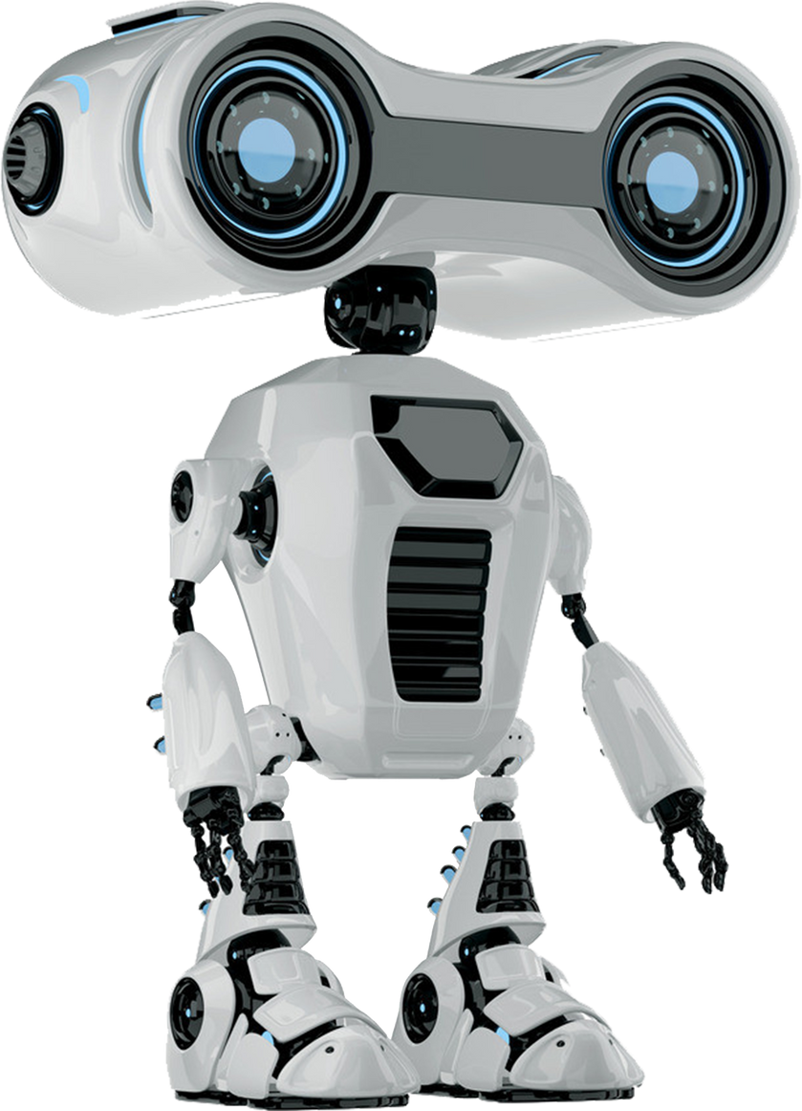


Made by: The Eagles

Slide 2

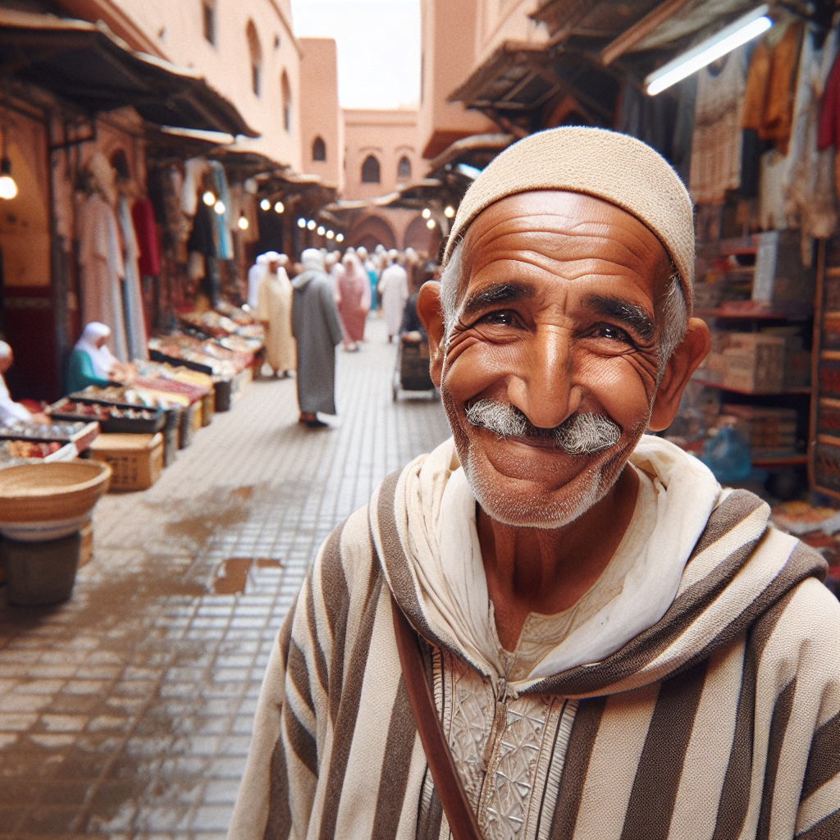
Seed Idea
Hassan, a Moroccan man, constantly hears about how AI is revolutionizing the future.
He’s eager to try these technologies.
He only speaks Darija

Slide 3
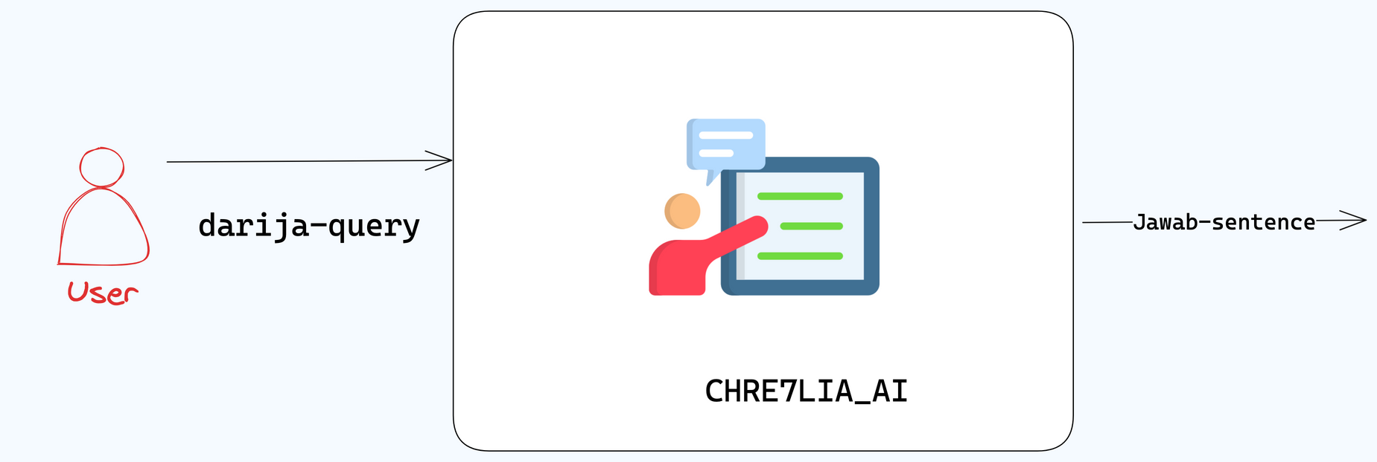
Use Case: CHRE7LIA_AI
Architecture

Slide 4
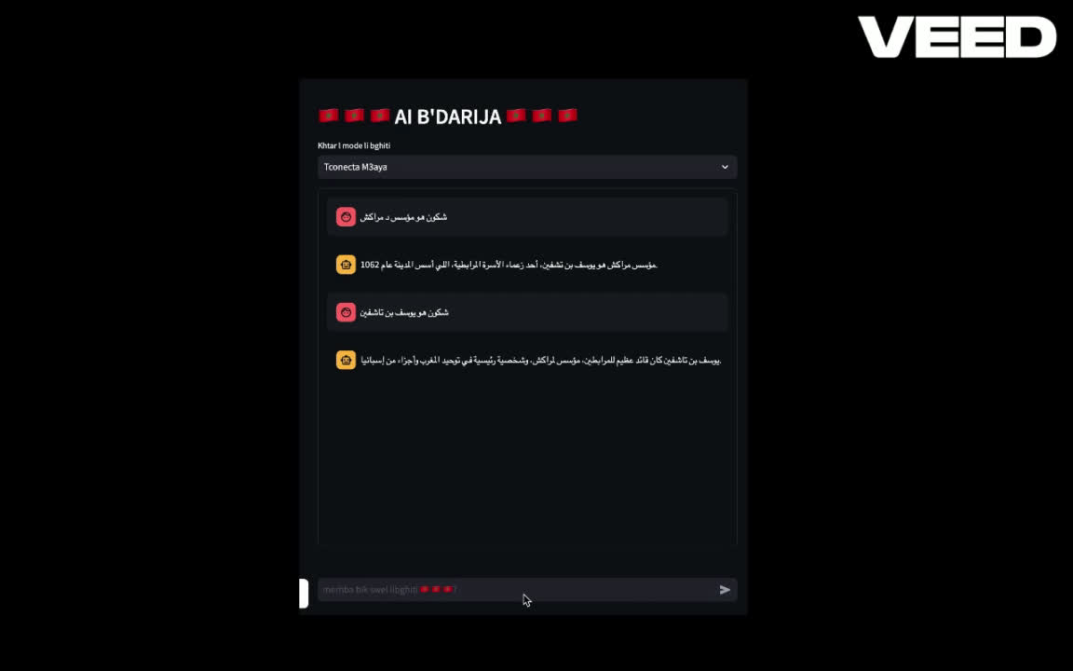
Use Case: CHRE7LIA_AI

Slide 5
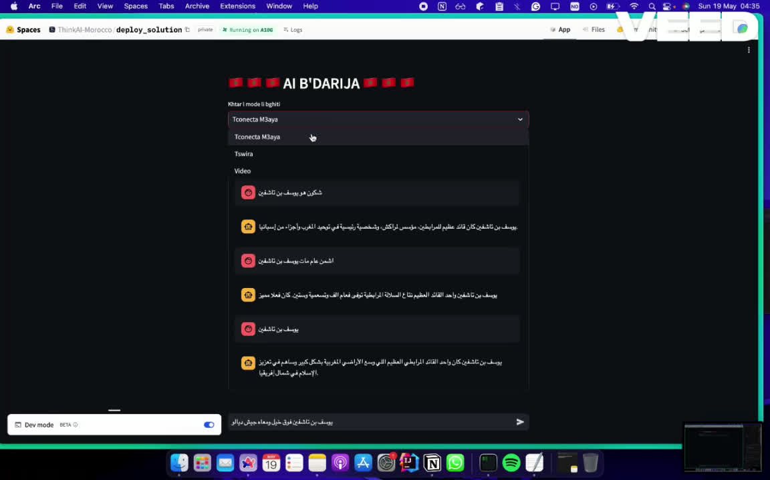
And More !!
Demo of generating an image

Slide 6
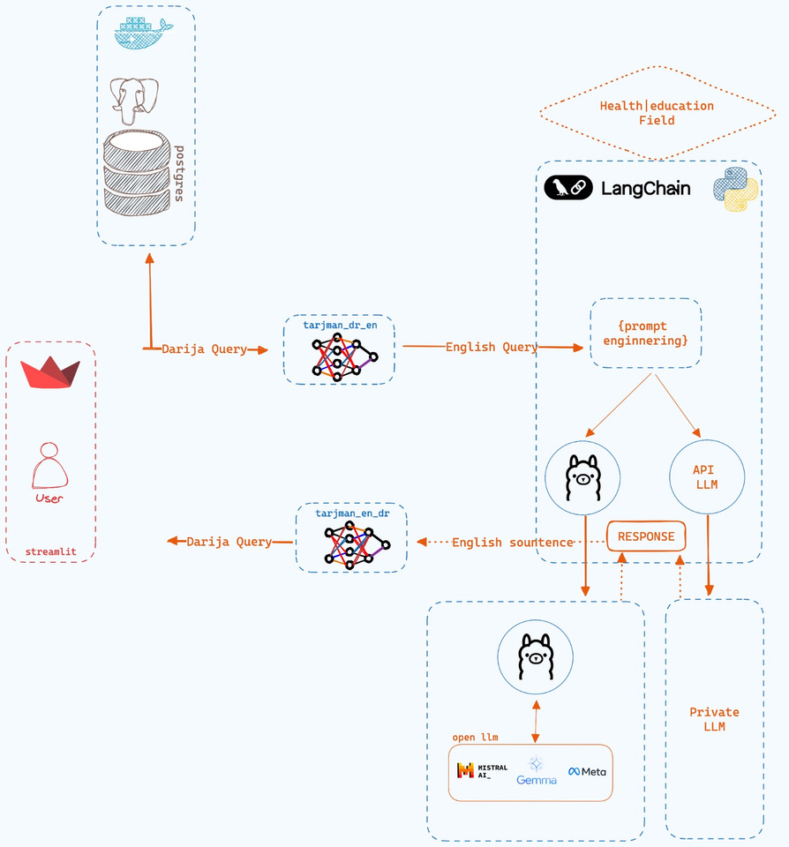

Global Architecture
Broker

Slide 7
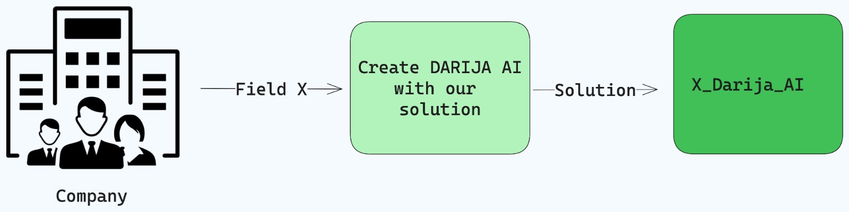
Business Idea

Slide 8
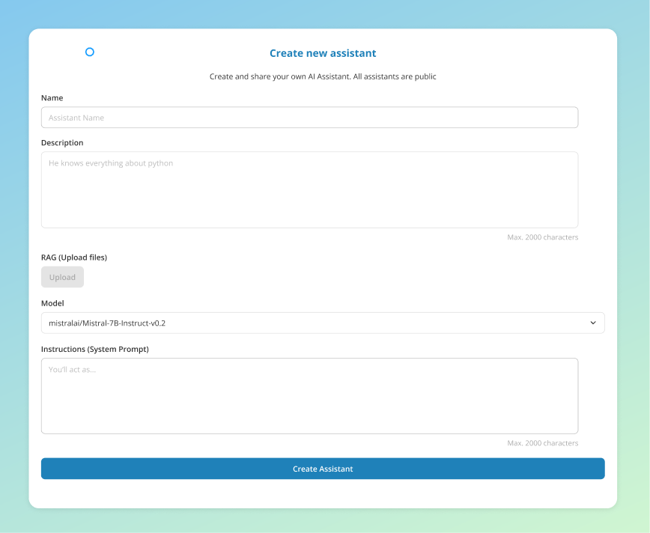
Business Idea

Slide 9

Business Model
Component | Details
Target Market | SMEs, large corporations, startups
Revenue Streams | Subscription fees, usage-based pricing
Channels | Direct sales, online marketing, partnerships
Unique Selling Point | Localized AI solution with Darija support

Slide 10
Future Improvement

Slide 11

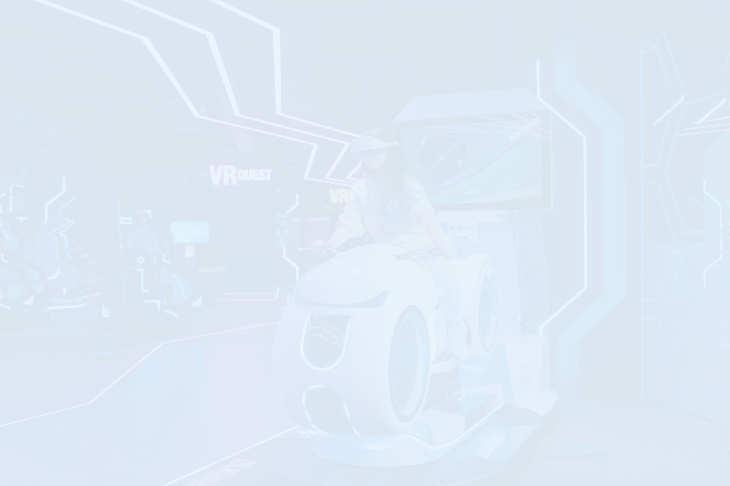


Thank you!
Get in Touch With Us
Ayoub Barka
Abdeljalil EL majoddi
Younes Benlaanaya

